Slide 1
EL JIM Web Design
CST 2309 – Maximo Antigua

Slide 2
Table of Contents.
1. Introduction
2. Base
3. Wireframe to Website
4. Website Live
5. Conclusion

Slide 3
Introduction
01

Slide 4
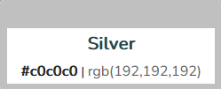
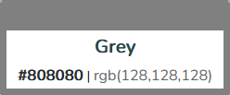
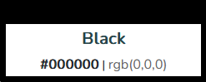
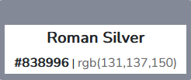
Base
02
Colors
Inspiration
Fonts
My idea came from the GYMS around me.
'Montserrat', Arial, sans-serif;

Slide 5
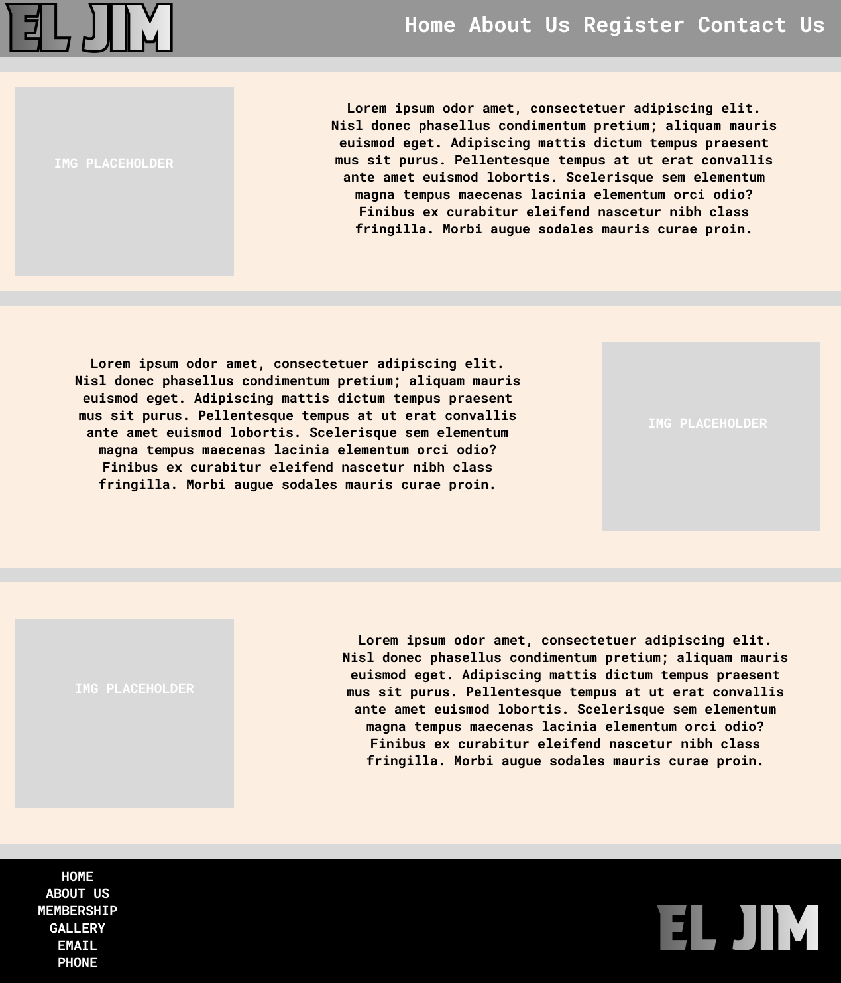

Wireframe to Website (1/4)
03
Wireframe
Website

Slide 6
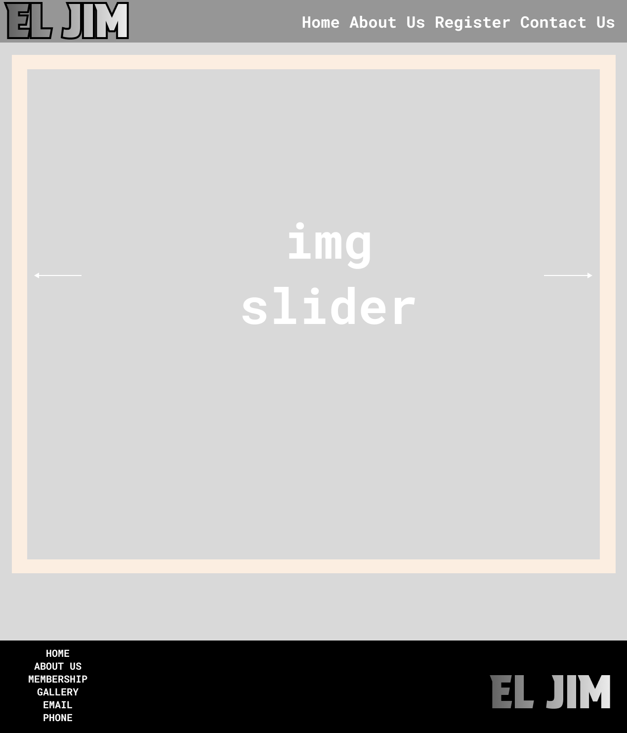

Wireframe to Website (2/4)
03
Wireframe
Website

Slide 7
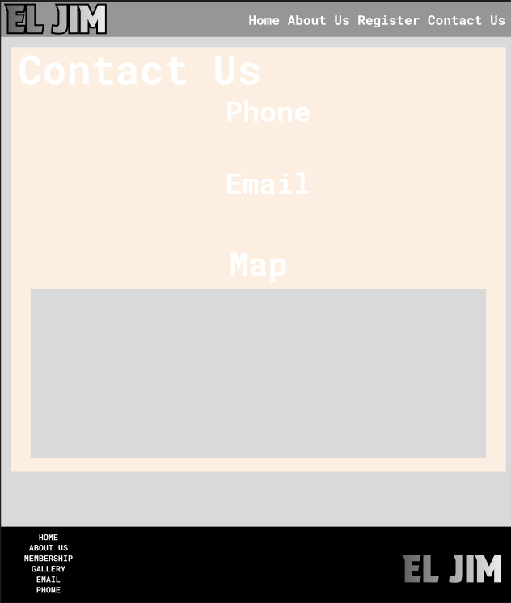
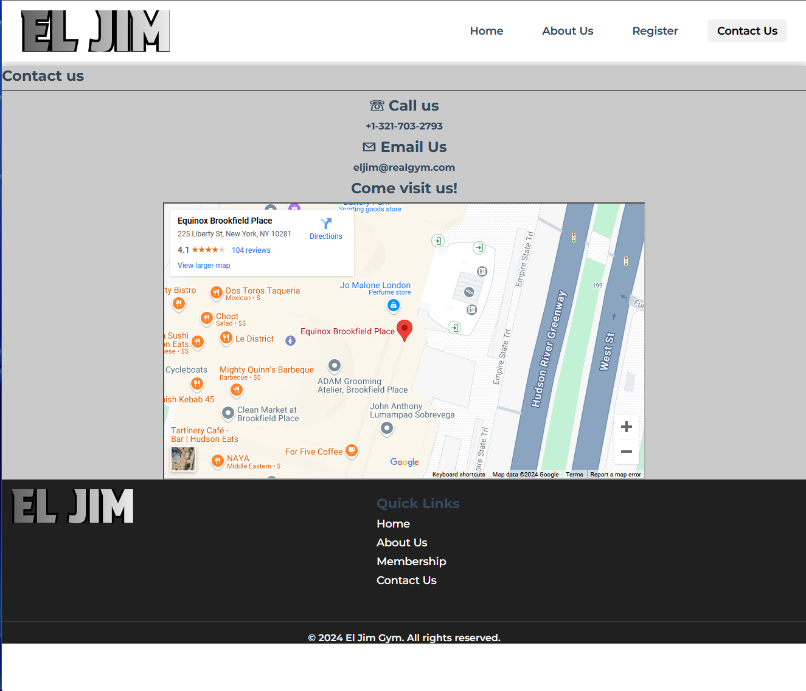
Wireframe to Website (3/4)
03
Wireframe
Website

Slide 8
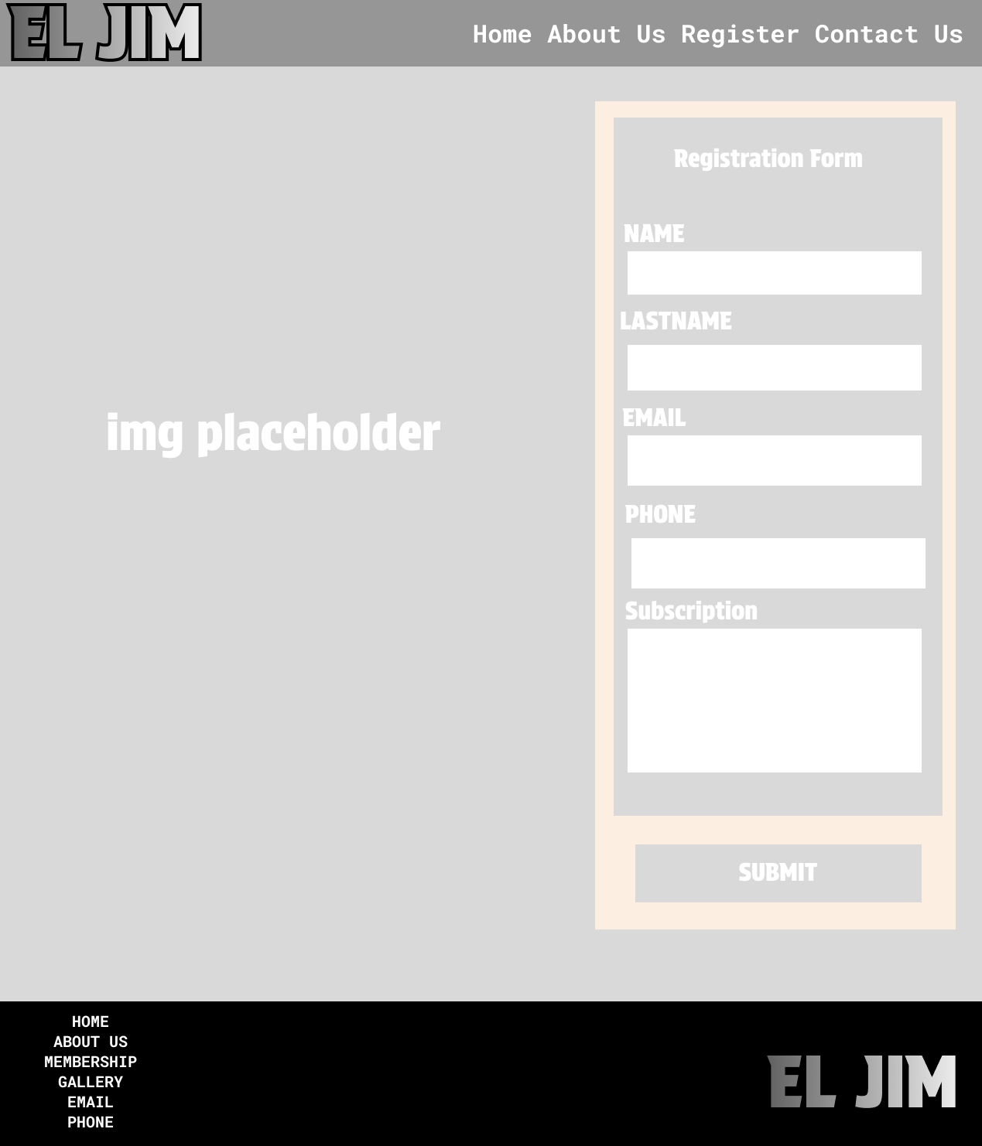
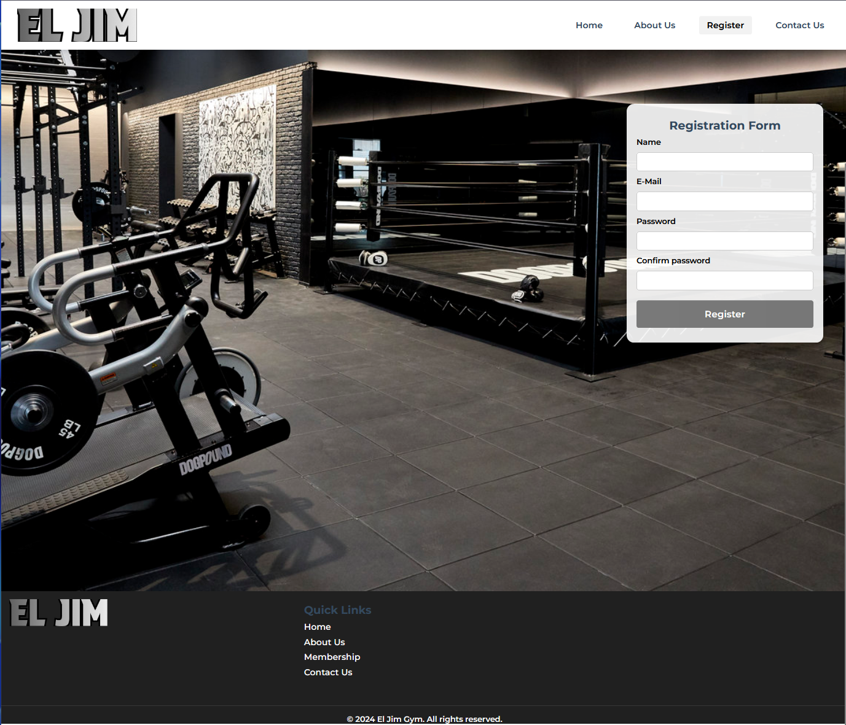
Wireframe to Website(4/4)
03
Wireframe
Website

Slide 9
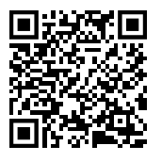
Thank you!

